Slide 1
Oiled Wildlife Management
CGPRT(W) : Ensuring Clean Seas and Coasts in Western Region ……

Slide 2
Objectives
To understand wildlife management techniques and wildlife response related issues during an oil spill
CGPRT(W) : Ensuring Clean Seas and Coasts in Western Region ……

Slide 3
Wildlife Response
Oil released in the marine environment can potentially affect significant numbers of animals, especially birds, and once washed ashore, pose a significant animal welfare and management problem
Oiled wildlife response planning should have been considered as part of general oil spill preparedness
CGPRT(W) : Ensuring Clean Seas and Coasts in Western Region ……

Slide 4
Wildlife Response
Includes activities undertaken to deal with wild animals that are/may be affected by an oil spill incident
Animals that are extremely vulnerable to an oil spill:
  use the surface of the water to rest
  dive through the surface of the water to feed
  break though the surface of the water to breathe
  Examples: sea turtles, seabirds, sea ducks, seals, otters
CGPRT(W) : Ensuring Clean Seas and Coasts in Western Region ……

Slide 5
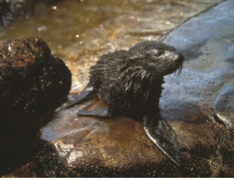
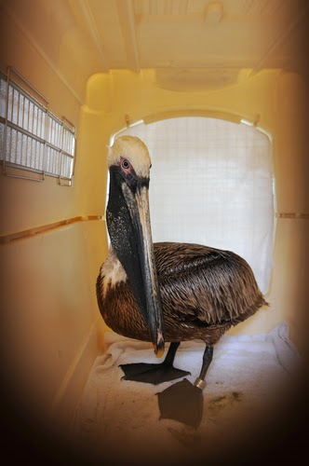
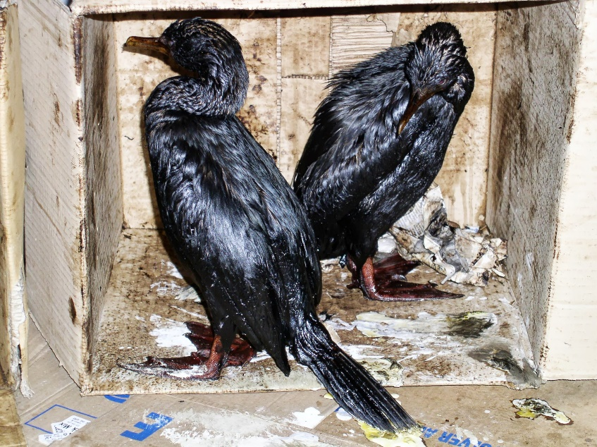
Wildlife Response
Source: ITOPF
Source: ITOPF
Source: USCG
CGPRT(W) : Ensuring Clean Seas and Coasts in Western Region ……

Slide 6
Wildlife Management
Planning
Environmental Impact Assessment (EIA)
Incident assessment
Wildlife response
Documentation
Response structure
CGPRT(W) : Ensuring Clean Seas and Coasts in Western Region ……

Slide 7
Planning
Carried out pre-spill and integrated into the contingency plan and addresses:
Resources at risk
Sensitivity mapping
Conservation responsibility
Public perception/responsibility
Regulations, permits, approvals
  Must comply with local regulations
CGPRT(W) : Ensuring Clean Seas and Coasts in Western Region ……

Slide 8
Wildlife Response
Planning should include
  Identification of species and areas vulnerable to oil pollution
  Actions to protect vulnerable species from oiling during a response
  Actions to enhance the treatment of live oiled animals
  Actions to enhance assessments of oil spill impact on wildlife populations
  Actions to enhance the effectiveness of an oiled wildlife response
CGPRT(W) : Ensuring Clean Seas and Coasts in Western Region ……

Slide 9
Planning
Determine expertise and resources required/available
Locate potential holding centres, rehabilitation facilities and transportation methods
Determine final disposal sites
Assess cost effective solutions
CGPRT(W) : Ensuring Clean Seas and Coasts in Western Region ……

Slide 10
Environmental Impact Assessment
A reliable scientific evaluation on what impact the spill has had, typically includes:
Scope of the impact to habitat, nesting areas and animals
Type of species and age structure
Number of dead/alive animals recorded and examined
Estimate of losses at sea
Endangered/protected species
Oiled wildlife team may support spill impact assessments
Post-release monitoring may assist evaluation of effectiveness
CGPRT(W) : Ensuring Clean Seas and Coasts in Western Region ……

Slide 11
Incident Assessment
To determine whether to respond consider...
Human health and safety
Wildlife impacts (data from EIA)
Location of sensitive areas
Effect of seasonality
Type and volume of oil spilled
Resources available and the need for external support
Considerations for oiled wildlife triage/euthanasia
CGPRT(W) : Ensuring Clean Seas and Coasts in Western Region ……

Slide 12
Wildlife Response
Measures to mitigate the effect of oil on animals:
Search and collection (dead and alive)
Transport
Reception
Triage
Treatment and washing
Post-wash treatment
Rehabilitation
Release
CGPRT(W) : Ensuring Clean Seas and Coasts in Western Region ……

Slide 13
Wildlife Response
Pro-active measures to prevent impact
Protect habitat and nesting areas from spilled oil
Remove oil from water or shoreline prior to wildlife impact
Hazing (deterrence) or pre-emptive capturing
CGPRT(W) : Ensuring Clean Seas and Coasts in Western Region ……

Slide 14
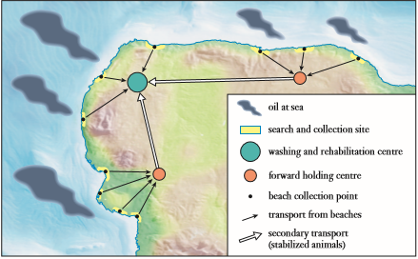
Wildlife Response
A geographic model of a response organization Source: IPIECA
CGPRT(W) : Ensuring Clean Seas and Coasts in Western Region ……

Slide 15
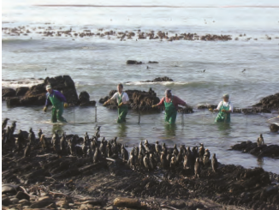
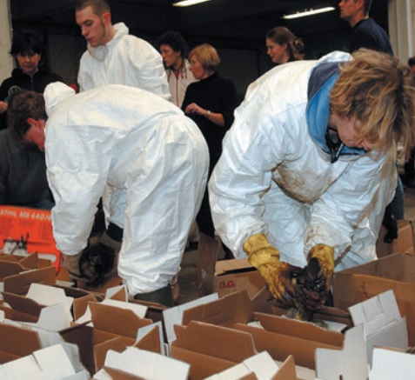
Wildlife Response
Source: ITOPF
Source: IPIECA/IOGP
CGPRT(W) : Ensuring Clean Seas and Coasts in Western Region ……

Slide 16
Documentation
Documentation is a critical component of Oiled wildlife management:
Record keeping, evaluation and reporting
Using a centralized Database
Labelling and record keeping in all areas from collection through to release/disposal
Evidence gathering
CGPRT(W) : Ensuring Clean Seas and Coasts in Western Region ……

Slide 17
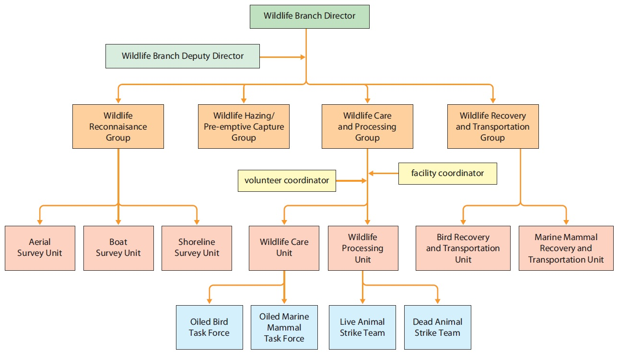
Wildlife Management Structure
Source: IPIECA/IOGP
CGPRT(W) : Ensuring Clean Seas and Coasts in Western Region ……

Slide 18
Wildlife Response Issues
Human health and safety
Waste management
Cross-border incidents/impacts
Volunteers
Public and media expectations/reactions
CGPRT(W) : Ensuring Clean Seas and Coasts in Western Region ……

Slide 19
Human Health and Safety
Response priority is human health and safety
Health and safety policy is required for wildlife response
  H & S for on-water activities
  H & S for shoreline activities
  H & S for wildlife response centres
CGPRT(W) : Ensuring Clean Seas and Coasts in Western Region ……

Slide 20
Waste Management
Liquid:
Oil
Oil/water mixture from washing operations
Solid:
Oiled dead carcasses
Excrement
Medical waste
Cleaning materials
  Sorbent materials
  PPE
CGPRT(W) : Ensuring Clean Seas and Coasts in Western Region ……

Slide 21
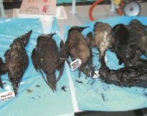
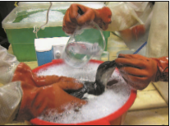
Waste Management
Source: IPIECA
Source: IPIECA
CGPRT(W) : Ensuring Clean Seas and Coasts in Western Region ……

Slide 22
Waste Management
Large numbers of freezers may be required for carcasses
Important to think about the waste stream before beginning wildlife response operations
Disposal sites for carcasses and other waste must be identified
CGPRT(W) : Ensuring Clean Seas and Coasts in Western Region ……

Slide 23
Cross-border Issues
Oil may impact wildlife in another jurisdiction or oiled wildlife may wash ashore in another location(national/international)
Legislation may differ with respect to wildlife collection/care/rehabilitation/release
Some countries require collection for evidence gathering
Policies with respect to euthanasia may differ
Cross-border resources and expertise may be available
CGPRT(W) : Ensuring Clean Seas and Coasts in Western Region ……

Slide 24
Volunteers
It is common for people to want to volunteer to help wildlife in an oil spill
Health and safety of volunteers is a priority
Proper training and supervision is required
Provide appropriate PPE
Robust registration and documentation procedures are required
Monitor for signs of stress and fatigue
Ensure proper insurance is in place
CGPRT(W) : Ensuring Clean Seas and Coasts in Western Region ……

Slide 25
Public/Media Expectations
Media will focus on wildlife!!
Media can affect public opinion
Public expectations may vary in different countries/cultures
CGPRT(W) : Ensuring Clean Seas and Coasts in Western Region ……

Slide 26
Conclusion
Health and safety of personnel is the first priority
Planning is a critical component to effective wildlife management, and includes assessing resources at risk, and identifying available expertise and response resources
Understand local legislation with respect to wildlife response, as well as policies in neighbouring jurisdictions
CGPRT(W) : Ensuring Clean Seas and Coasts in Western Region ……

Slide 27
Any questions?
CGPRT(W) : Ensuring Clean Seas and Coasts in Western Region ……

